Slide 1
Lecture 5: Exercise--Normal Curve, Linear Transformations, and Standard Scores
Jibo He, Ph.D.
Associate Professor
Wichita State University
jibo.he@Wichita.edu

Slide 2
Review of what we’ve learned
Rule about normal curve--- The rule tells us the amount of area under the normal curve that is located between certain points (expressed in standard deviation units). Approximately 68% of the area is found between one standard deviation above and below the mean.
Linear transformation---
Standardized Z-score

Slide 3
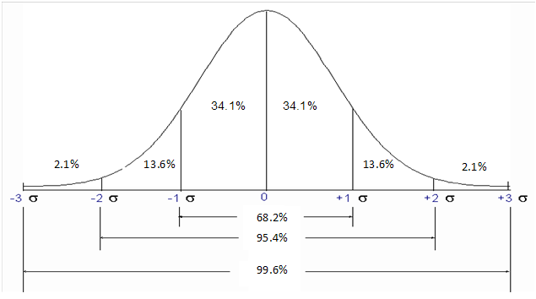
Distribution Features
We can see that for a normally distributed variable (such as test score), approximately two-thirds of the scores lie within one standard deviation of the mean (34.1% + 34.1% = 68.2%)

Slide 4
Review 2
Properties of Z-scores
Z scores always have a mean of 0 and a standard deviation of 1
The magnitude of a Z score is the number of standard deviations between its raw score and the mean, where as the sign of a Z score (+ or –) indicates the direction of the corresponding raw score relative to the mean
Z scores make it possible to compare raw scores that have different units of measurement
Table of areas under the normal curve

Slide 5
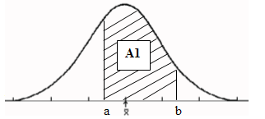
Area under the curve
The area under the curve between a and b is:
the percentage of all possible observations that have a score between a and b;

Slide 6
Normal Distribution
A score on the Z-axis divides the standard normal curve into two parts: There is a portion of the curve to the left of the Z score and a portion of the curve to the right of the Z score
The area under the curve and to the left of a Z score is the percentage of observations that are less than that Z score
The area under the curve and to the right of a z score is the percentage of observations that are greater than that Z score.

Slide 7
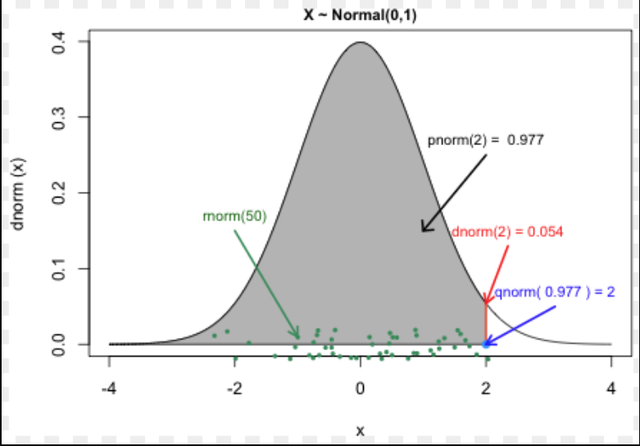

Slide 8
R: pnorm and qnorm
pnorm:
Given a number or a list it computes the probability that a normally distributed random number will be less than that number.
qnorm:
The idea behind qnorm is that you give it a probability, and it returns the number whose cumulative distribution matches the probability. For example, if you have a normally distributed random variable with mean zero and standard deviation one, then if you give the function a probability it returns the associated Z-score

Slide 9
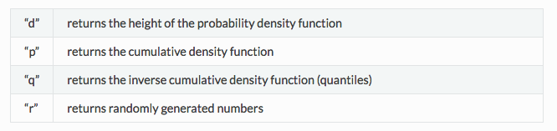
R: pnorm and qnorm

Slide 10
Finding a Score When the Area Under the Normal Curve Is Known
We can also use the normal distribution table to identify an interval which corresponds to a specified probability
Step 1: Identify the proportion / area designated in the question and graphically display it along with the boundaries of the interval that you are looking for

Slide 11
Finding a Score When the Area Under the Normal Curve Is Known
Step 2: Use the Standard Normal Table to find the value(s) of Z that corresponds to the boundaries of the designated interval. You may need to re-specify the area so that it corresponds to one of the areas in the table.

Slide 12
Percentile and Percentile Ranks
Percentile
Point on the measurement scale below which a given percentage of the scores fall
Symbolized P_{a}
Percentile may have any value that scores X may have
Example: P₅₀ = 81: The 50th percentile is 81. 50% of the scores in the distribution fall below a score of 81

Slide 13
Percentile Rank- (a percentage)
The percentage of scores falling below a given point on the measurement scale
Symbolized PR_{a}
Percentile rank may take values only between 0 and 100
Example: PR₈₁=50: The percentile rank of a score of 81 is 50. 50% of the scores in the distribution fall below a score of 81.

Slide 14
Percentile and Percentile Ranks
Exercise 1: Suppose that John earned a score of 148
on a college entrance test and that 77% of applicants
score lower. What is the 77th percentile? What is
John’s percentile rank?
Exercise 2:
(a) Can a percentile have the value of 600?
(b) Can a percentile have the value of – 3.5?
(c) Can a percentile rank have the value of 600?
(d) Can a percentile rank have the value of -3.5?

Slide 15
Simple Warm-up Exercise
In a normal distribution, what proportion of scores fall between 1 and 3 standard deviations above the mean?
In a normal distribution, what proportion of scores fall between 2 and 4 standard deviations below the mean?
Notes:
a) .16 b) .02

Slide 16
Exercise 2
Suppose that we convert the IQ test score (raw scores X) into standard scores (z-score units) using our usual equation for computing z-scores
Suppose we transform the Z scores once again into a distribution of IQ scores using the following equation:
What are the values of the mean and the standard deviation of this new IQ score?

Slide 17
Exercise 3
In a normal distribution with a mean (µ) of 150 and a standard deviation (σ) of 20, what is the percentile rank of each of the following scores?
120
163
Notes:
. a) 7th or P_{.07} ; c) 74th or P_{.74} 思考如何用excel和R实现

Slide 18
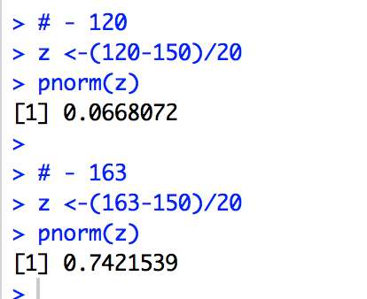
Exercise 3
In a normal distribution with a mean (µ) of 150 and a standard deviation (σ) of 20, what is the percentile rank of each of the following scores?
120
163
Notes:
. a) 7th or P_{.07} ; c) 74th or P_{.74} 思考如何用excel和R实现

Slide 19
Exercise 4
In a normal distribution with µ = 50 and σ = 8, find the following percentile points.
95th
15th

Slide 20
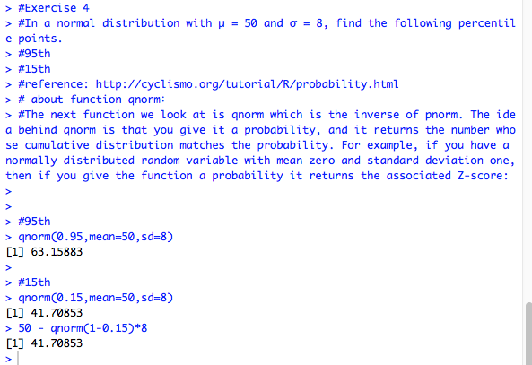
Exercise 4
In a normal distribution with µ = 50 and σ = 8, find the following percentile points.
95th
15th

Slide 21
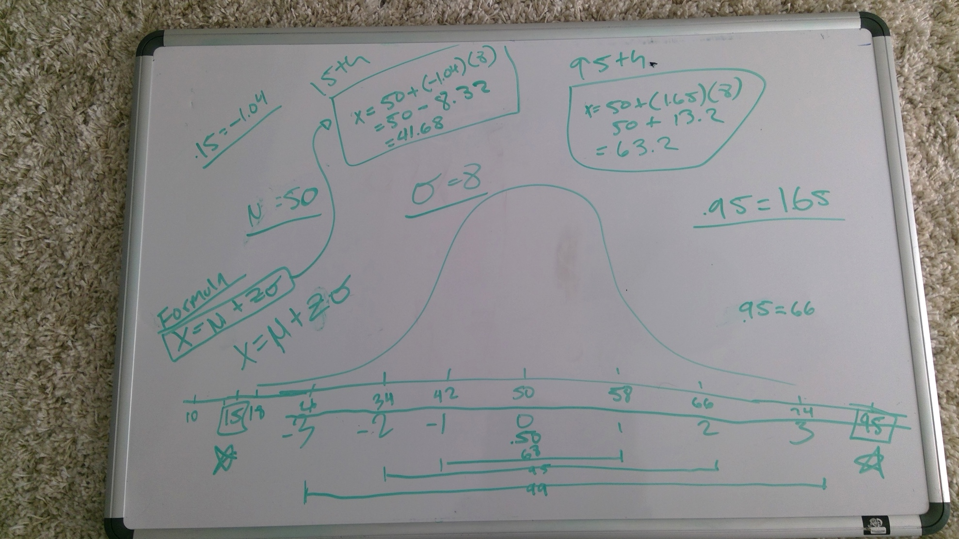
Exercise 4

Slide 22
Exercise 5
In a normal distribution with µ = 100 and σ = 10, what proportion of scores fall between each of the following pairs of scores?
90 – 110
85 – 112

Slide 23
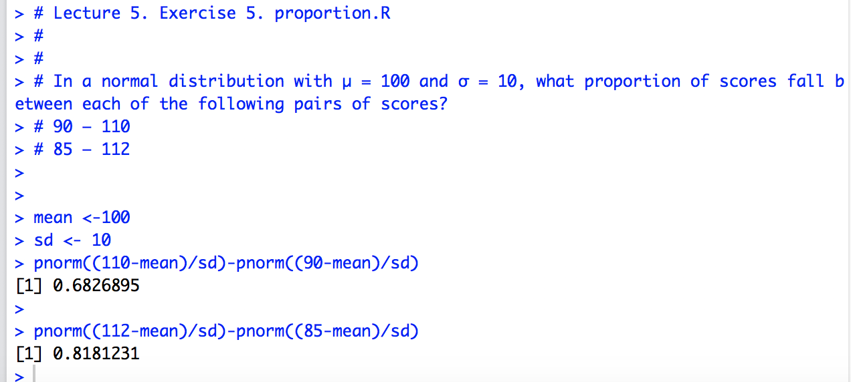
Exercise 5
In a normal distribution with µ = 100 and σ = 10, what proportion of scores fall between each of the following pairs of scores?
90 – 110
85 – 112

Slide 24
Exercise 6
“The length of human pregnancies from conception to birth varies according to a distribution that is approximately normal with a mean 266 days and a standard deviation 16 days.”
(1) What percent of pregnancies last less than 240 days (8 months-ish)?
(2) What percent of pregnancies last between 240 and 270 days?
(3) How long do the longest 20% pregnancies last?

Slide 25
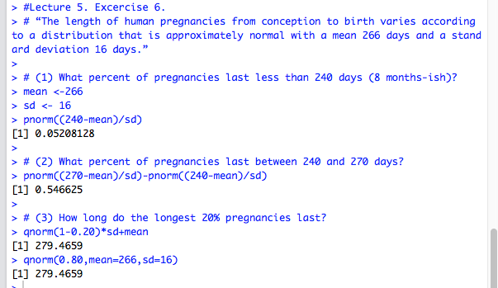
Exercise 6

